Slide 1
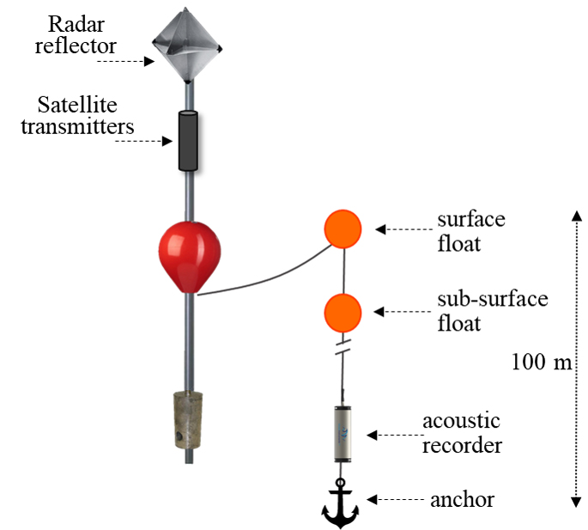
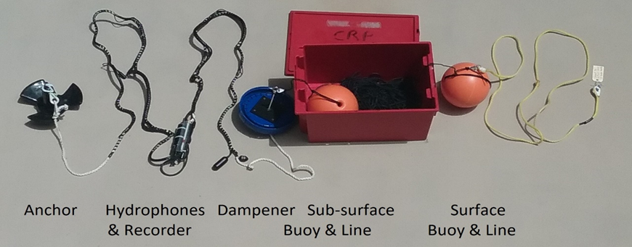
BUOY PREPARATION
Day Before. Turn on SPOT transmitters, check (https://maps.findmespot.com/s/7PN0). Vacuum pump Spot cylinder (8-10psi).
Assemble High Flyer
Attach bridle from orange line to High Flyer (1 above/1below float) (zip tie)
Lay line on deck (no tangles!)
Attach weight to line below recorder (zip tie)
Turn on Recorder (see green light).
Point remote at clear end of Recorder, press START
RED will light, then GREEN will light, then GREEN will blink 1x/4sec (hard to see in direct sunlight).
After 2 min, will go into SLEEP MODE
Will flash briefly every 20 min (hard to see)
DEPLOYMENT
Prepare buoy for deployment (see other side)
Note Array ID (yellow tag at top of array)
Discuss plan with crew, check satellite reception online
Double-check buoy preparation, recorder is ON
Location Specs: >200m depth, far from shipping lanes
Slow vessel to 2-3knots, prepare to deploy OFF STERN
Prepare anchor (loop line for deploy- but will go in LAST!)
Lower High Flyer into water
Pay out line at vessel speed (no excess line)
Lower recorder into water (gentle! Do not toss!)
Lower anchor into water (do not toss!)
Mark time/Lat/Long and Array ID, send to Shannon

